Slide 1








Slide 2








CRIXIS
An Academic Tracker

Slide 3




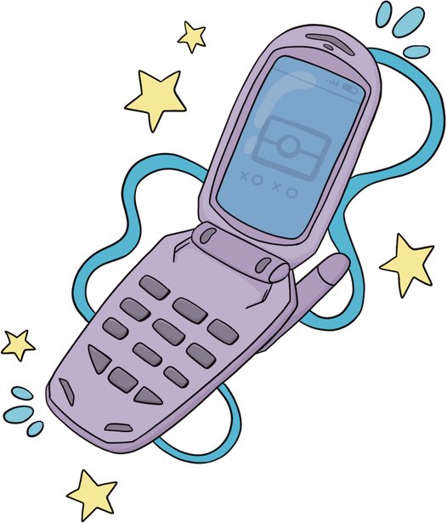




THE PROBLEM
·Throughout the school year, many outputs, activities, and quizzes would be given out, remembering each due date or simply placing it on your calendar can lead to it being easily forgotten. Many students receive low grades because they are either; not prepared, forgot the date, or have no output at all, because he/she couldn’t keep track of their requirements.

Slide 4



program description
Our program is designed to help each student in their academics, specifically in the organization and reminding of their due dates and/or upcoming activities, quizzes, or exams. By giving the students regular notifications regarding their requirements and to encourage students to study and/or work on any upcoming assessments.

Slide 5








OBJECTIVES
To encourage students to study, prepare or simply to help students become more disciplined on their study habits.
To help students be reminded of their pending projects and upcoming quizzes/activities/exams.

Slide 6
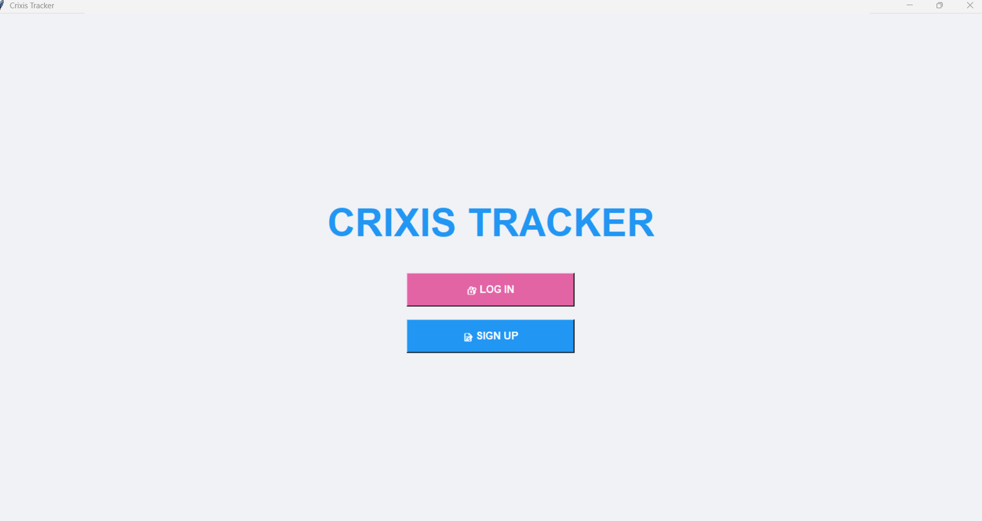



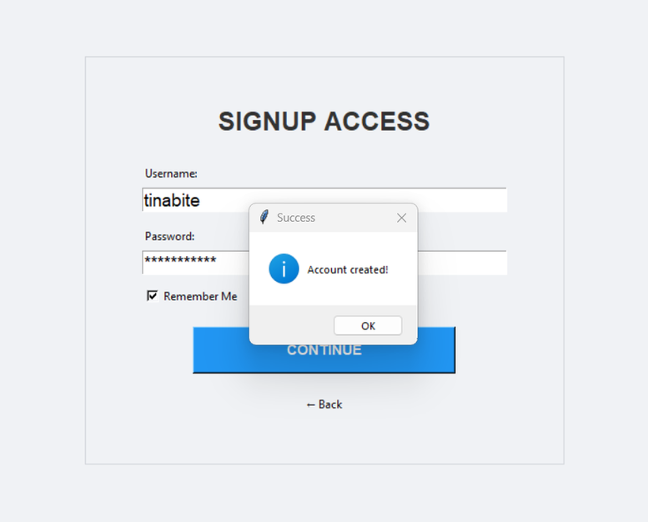
Feature
Feature
implementation
implementation
User log in/sign up

Slide 7
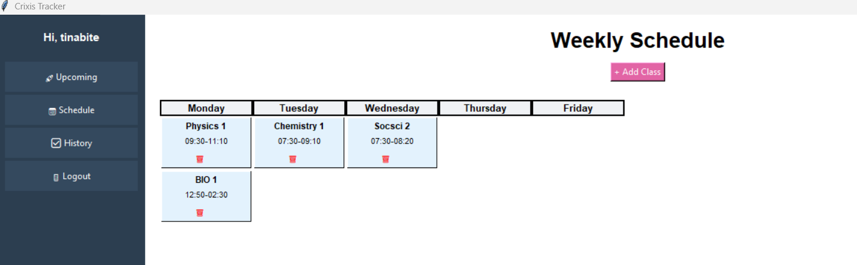
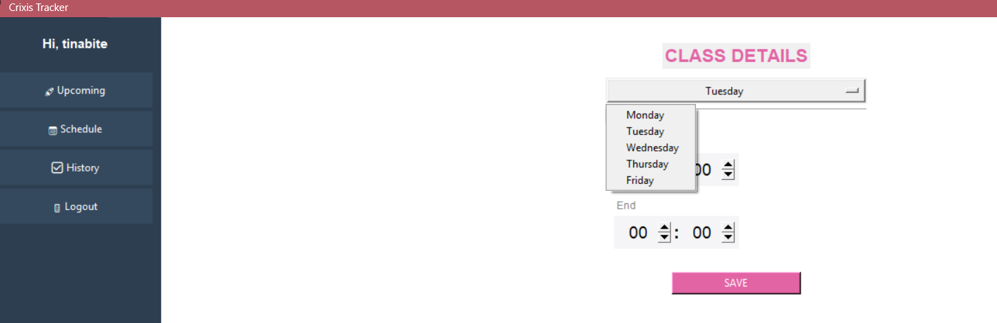
Feature
Feature
implementation
implementation
A weekly schedule input

Slide 8
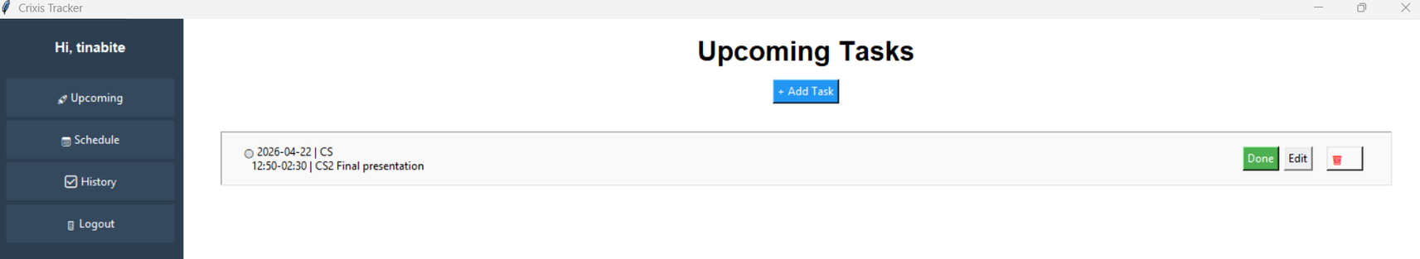
Feature
Feature
implementation
implementation
A space to place any upcoming due dates or outputs

Slide 9
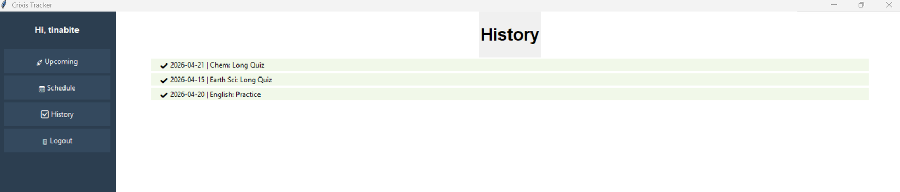
Feature
Feature
implementation
implementation
A history tracker to store finished tasks

Slide 10
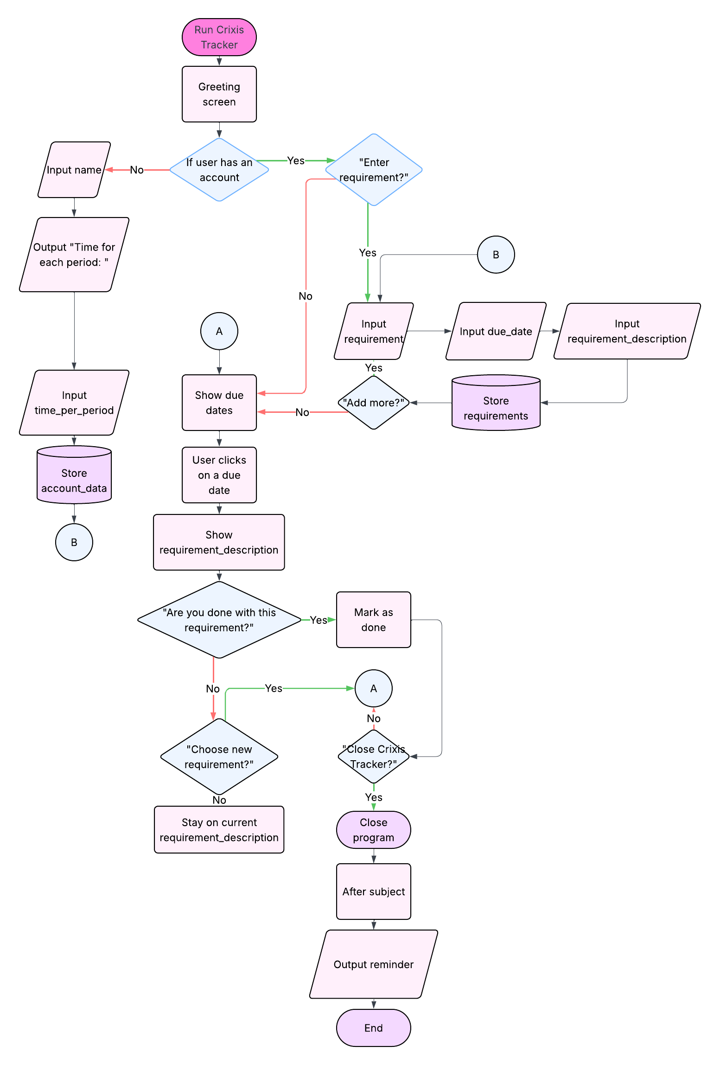

process flow diagram

Slide 11
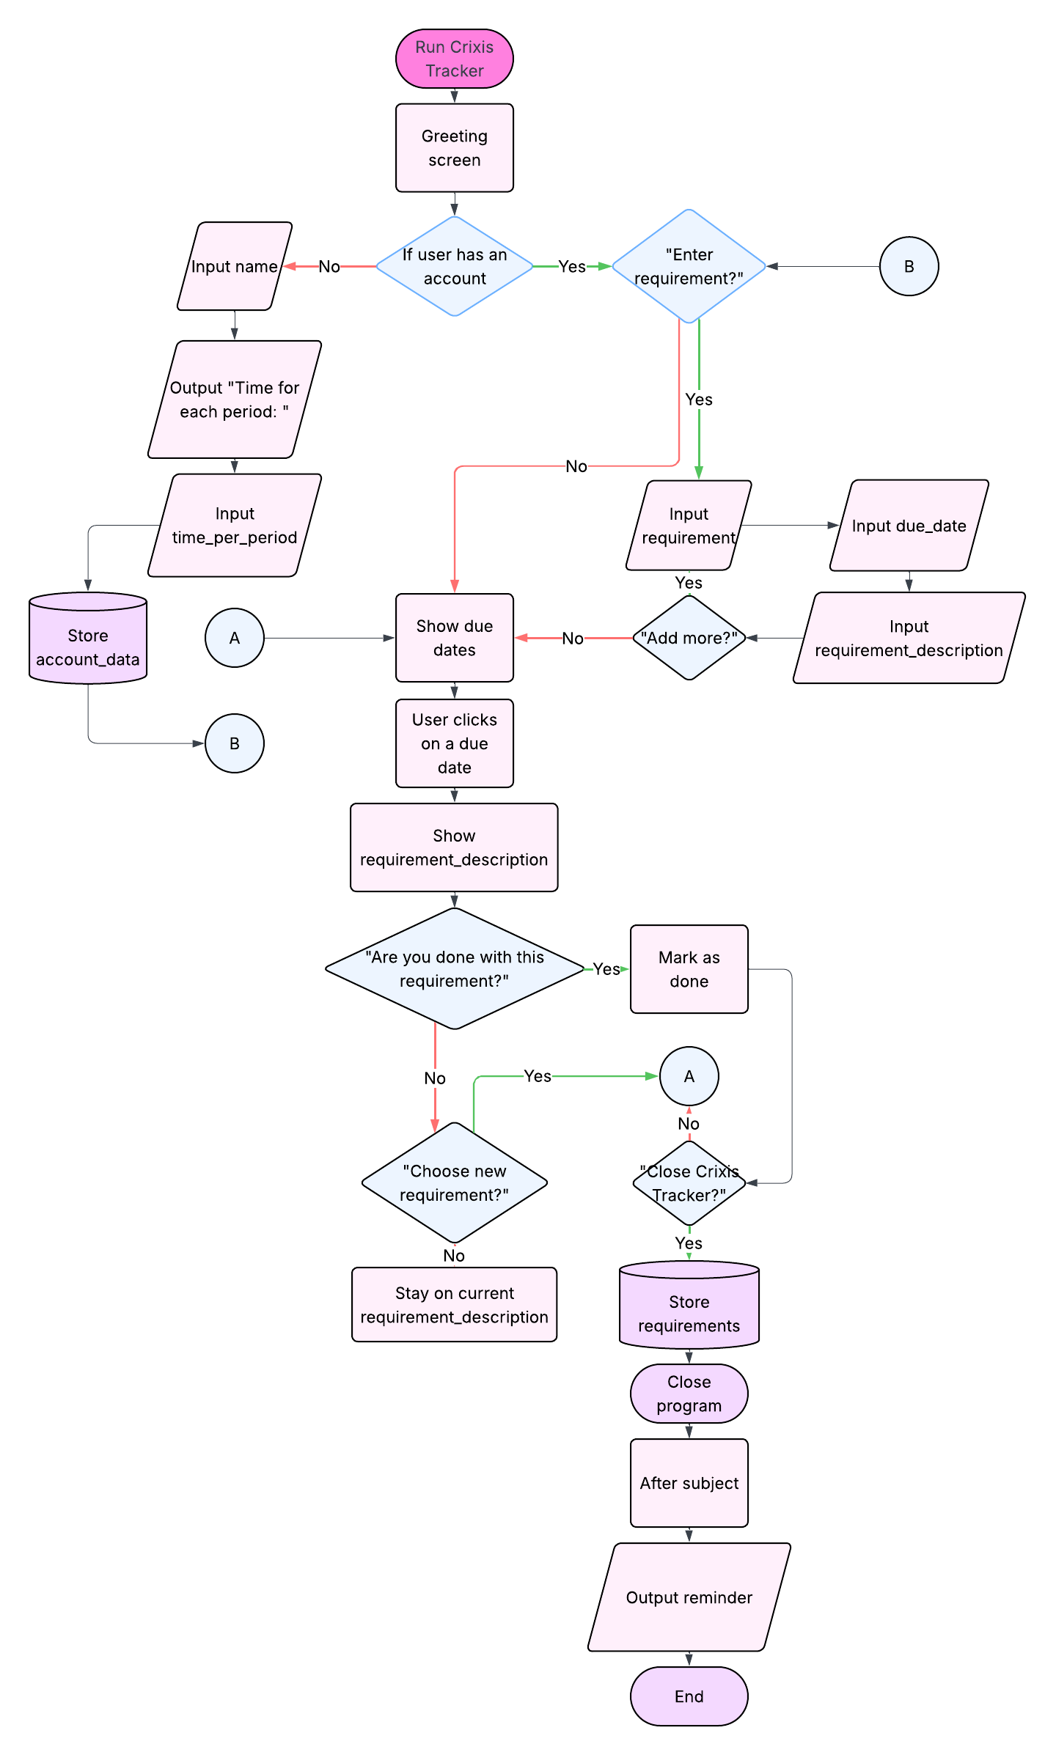
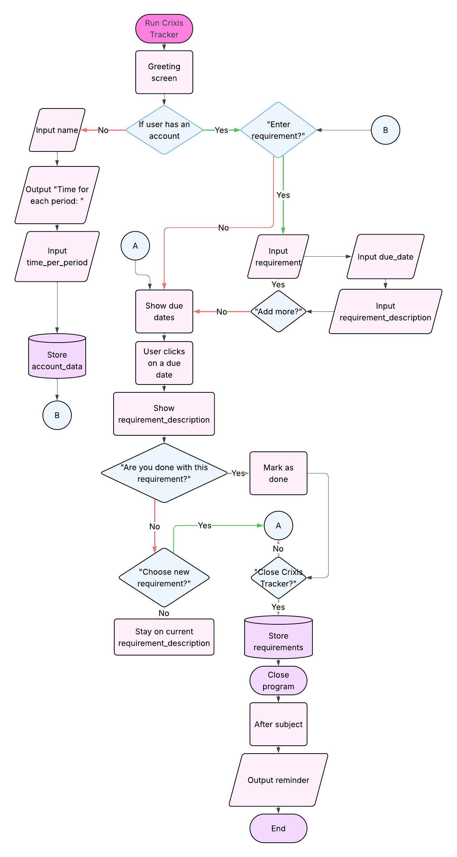
process flow diagram
The Crixis Tracker program initiates by greeting the user and immediately checking if they possess an existing account. If the user is new, the program prompts them to input their name, followed by defining a necessary time unit for each tracking period, storing the information right after.

Slide 12
Process flow diagram
The core functionality then pivots around whether the user is ready to enter a new requirement. If they choose to proceed, they input the requirement's title, its due date, and a detailed description, and are then asked if they wish to add more tasks. If they decline adding more (or if they initially chose not to enter any requirements), the program displays the consolidated list of all entered due dates.

Slide 13
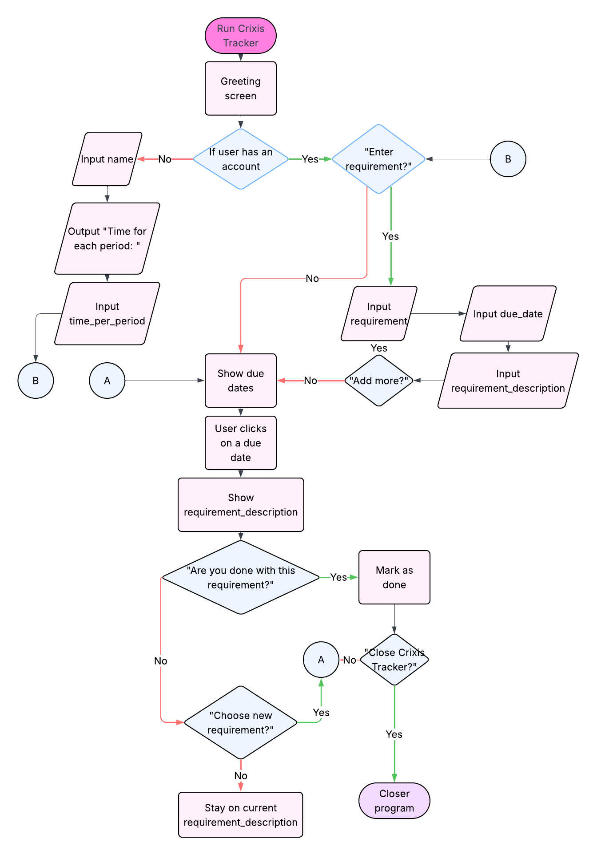
Process flow diagram
From this list, the user can select any due date to view its associated detailed description. After reviewing the details, the user is presented with a decision: to mark the requirement as done, or to continue. If marked as done, the system updates the status and returns the user to the list of due dates.

Slide 14
Process flow diagram
If the user chooses not to mark it as done, they are asked if they want to choose a new requirement to view. Choosing yes directs them back to the due date list, while choosing no keeps them on the current description page. A final option to close the Crixis Tracker is always available, leading directly to the termination of the program. But even while the program is not running, there will be a notification system following the inputted schedule.

Slide 15



conclusion
The Crixis Tracker is an effective program for managing academic and project workloads. It simplifies the challenge of multiple deadlines by providing a centralized system for logging and tracking activities, quizzes, exams, and assignments with their due dates. By offering a structured workflow for inputting, visualizing, and marking tasks as complete, Crixis Tracker acts as a practical digital assistant, promoting organization and ensuring accountability to reduce the risk of missed deadlines.

Slide 16

Thank You

